Slide 1
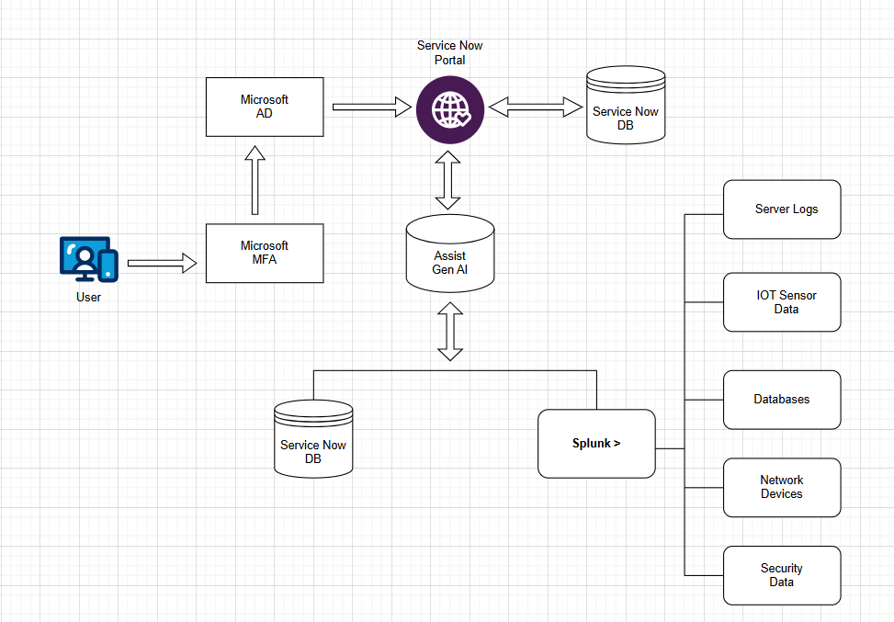
Gen AI enabled Integrated Platform Environment

